Slide 1
PCA on MNIST Dataset
1
Notes:
1

Slide 2
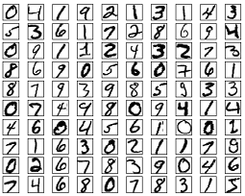
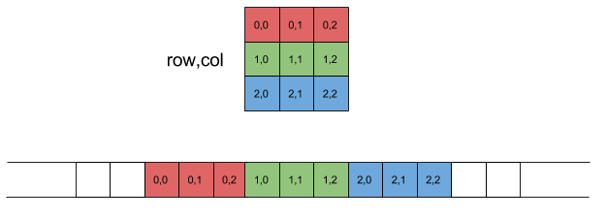
MNIST Dataset
The MNIST database of handwritten digits has a training set of 60,000 examples, and a test set of 10,000 examples
Each image has 28 x 28 pixels
CSV files is offered → Can use pandas library to read data
Each data point is flatten(row-major) in CSV file
Row-major flatten
2

Slide 3
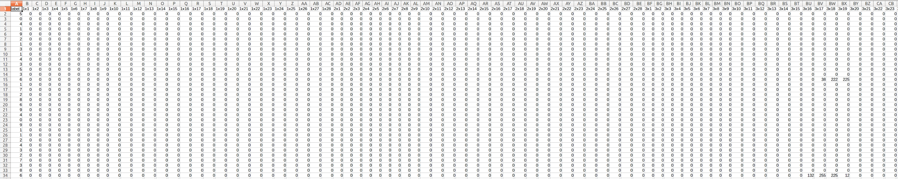
MNIST Dataset
Label
Pixel
3

Slide 4


PCA on MNIST Dataset
M : data feature dimension
N : number of data
Perform SVD on data matrix or PCA on scatter matrix
U matrix are eignvectors
Use k eignvectors to reconstruct image
M x N
M x K
x
U
K x K
K x N
$$Σ$$
V
$$≈$$
SVD on data matrix
4

Slide 5
Homework should included
Report
Code(in python)
Readme(library version, how to run the code)
Due date: 2020/10/27
5

